Slide 1
Unveiling Heart Disease Insights: A Data Analysis Exploration
-Anieruth S

Slide 2

Unveiling Heart Disease Insights
Chest Pain and Heart Disease:
Chest pain types labeled as 1 and 2 appear more frequently in patients with heart disease.
Type 0 chest pain is more prevalent among those without heart disease.
This suggests a possible correlation between chest pain type and the presence of heart disease, warranting further investigation.
This initial finding suggests a possible correlation, but further studies are needed to establish a causal relationship.

Slide 3
Age Distribution in the Data
Visual analysis reveals a middle-aged majority in the data.
The number of individuals decreases at younger and older extremes.
This distribution might warrant further exploration regarding age-related factors in heart disease.
Taking a closer look at the age distribution within the data, we discovered a trend towards a middle-aged majority.
The number of individuals significantly decreased at both younger and older age ranges.
This pattern warrants further investigation to understand how age-related factors might influence the risk of heart disease.

Slide 4
Exploring Correlations
Age vs. MaxHR (Maximum Heart Rate): This analysis confirmed the expected decline in physical capacity with age. Younger individuals tended to achieve higher maximum heart rates during exercise compared to older individuals.
Resting Blood Pressure vs. Heart Disease: Interestingly, a negative correlation existed between resting blood pressure and the presence of heart disease. While lower blood pressure is generally considered favorable, it might not guarantee freedom from heart disease due to potentially unmeasured risk factors.
Cholesterol vs. Fasting Blood Sugar: This negative correlation suggested that higher cholesterol doesn't necessarily translate to higher fasting blood sugar levels. However, both remain independent risk factors for heart disease.
MaxHR vs. Other Features: Negative correlations were observed between maximum heart rate and features like blood pressure, cholesterol, and vessel coloring. These might be related to individual variations in response to exercise and overall health.

Slide 5
Age and Coloured Vessels
Our analysis revealed an interesting pattern regarding age and colored vessels.
The data suggested a potentially higher prevalence of colored vessels in the 50-60 age group compared to younger and older individuals.
This finding could indicate a link between middle age and certain health conditions that necessitate vessel fluoroscopy, a procedure used to visualize blood vessels.
Further investigation is needed to explore this potential association.

Slide 6
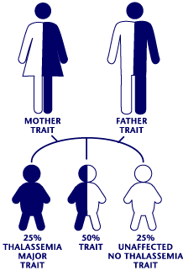
Thalassemia severity and Age
The analysis also shed light on a potential relationship between age and Thalassemia severity.
The data indicated that the prevalence of Thalassemia with a reversible defect (category 2) increased with age, particularly noticeable in individuals above 50 years old.
This trend may suggest a heightened risk of developing more severe Thalassemia forms in older individuals.
This finding underscores the importance of implementing age-specific screening and preventive measures to address this potential risk.

Slide 7
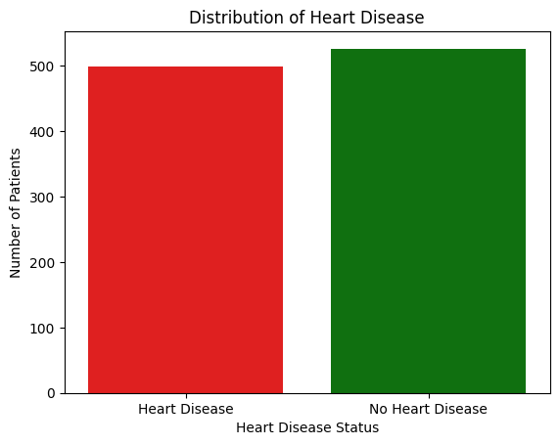
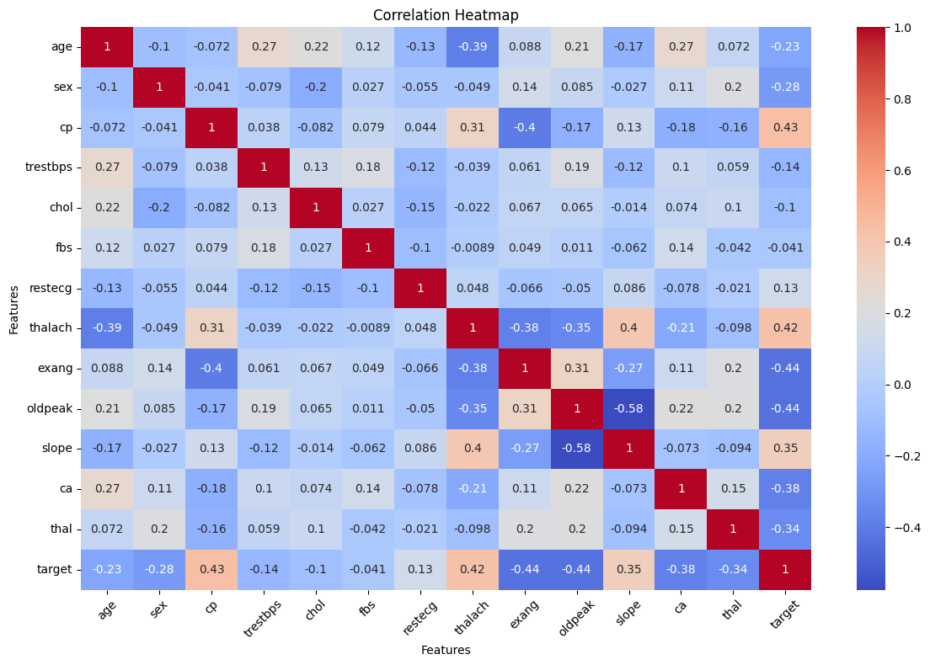
Data Visualizations

Slide 8
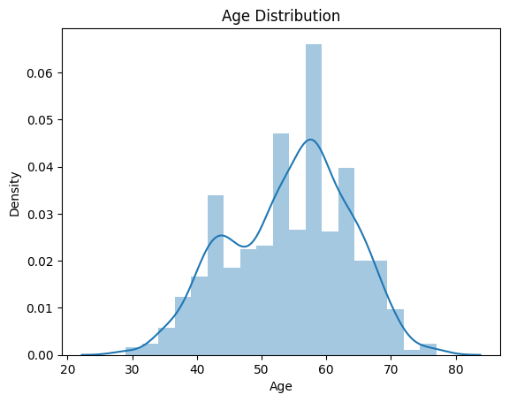
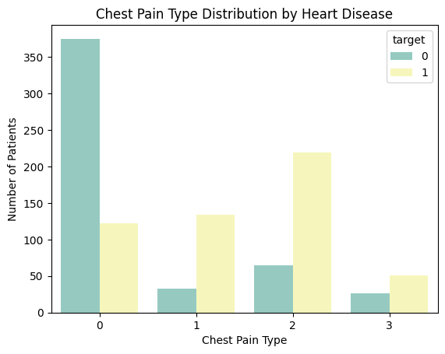
Data Visualizations

Slide 9
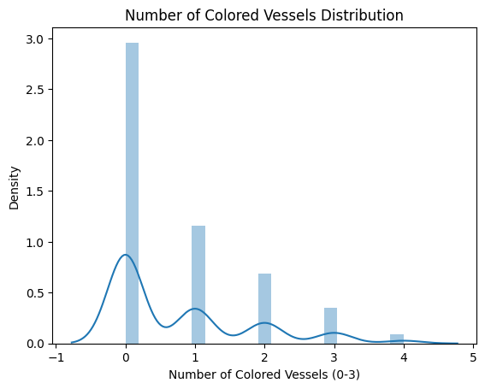
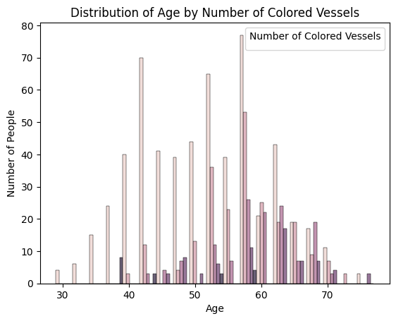
Data Visualizations

Slide 10
Conclusion
In conclusion, this data analysis has yielded valuable insights into potential relationships between various factors and heart disease.
We observed a possible correlation between chest pain types and heart disease, highlighting the need for further investigation.
Additionally, the age distribution suggests a middle-aged majority, prompting exploration of age-related risk factors.
Furthermore, correlations between features like age and MaxHR, resting blood pressure, and Thalassemia severity provided valuable insights.
Finally, the analysis of colored vessels across age groups suggests a potential link to middle age and certain health conditions.
These findings contribute to a better understanding of heart disease and can serve as a foundation for further research and the development of improved preventive measures.

